Slide 1
Reel Review
Movie Recommender
Leonardo Lopez
Michael Guynn
Nuha Aldausari

Slide 2
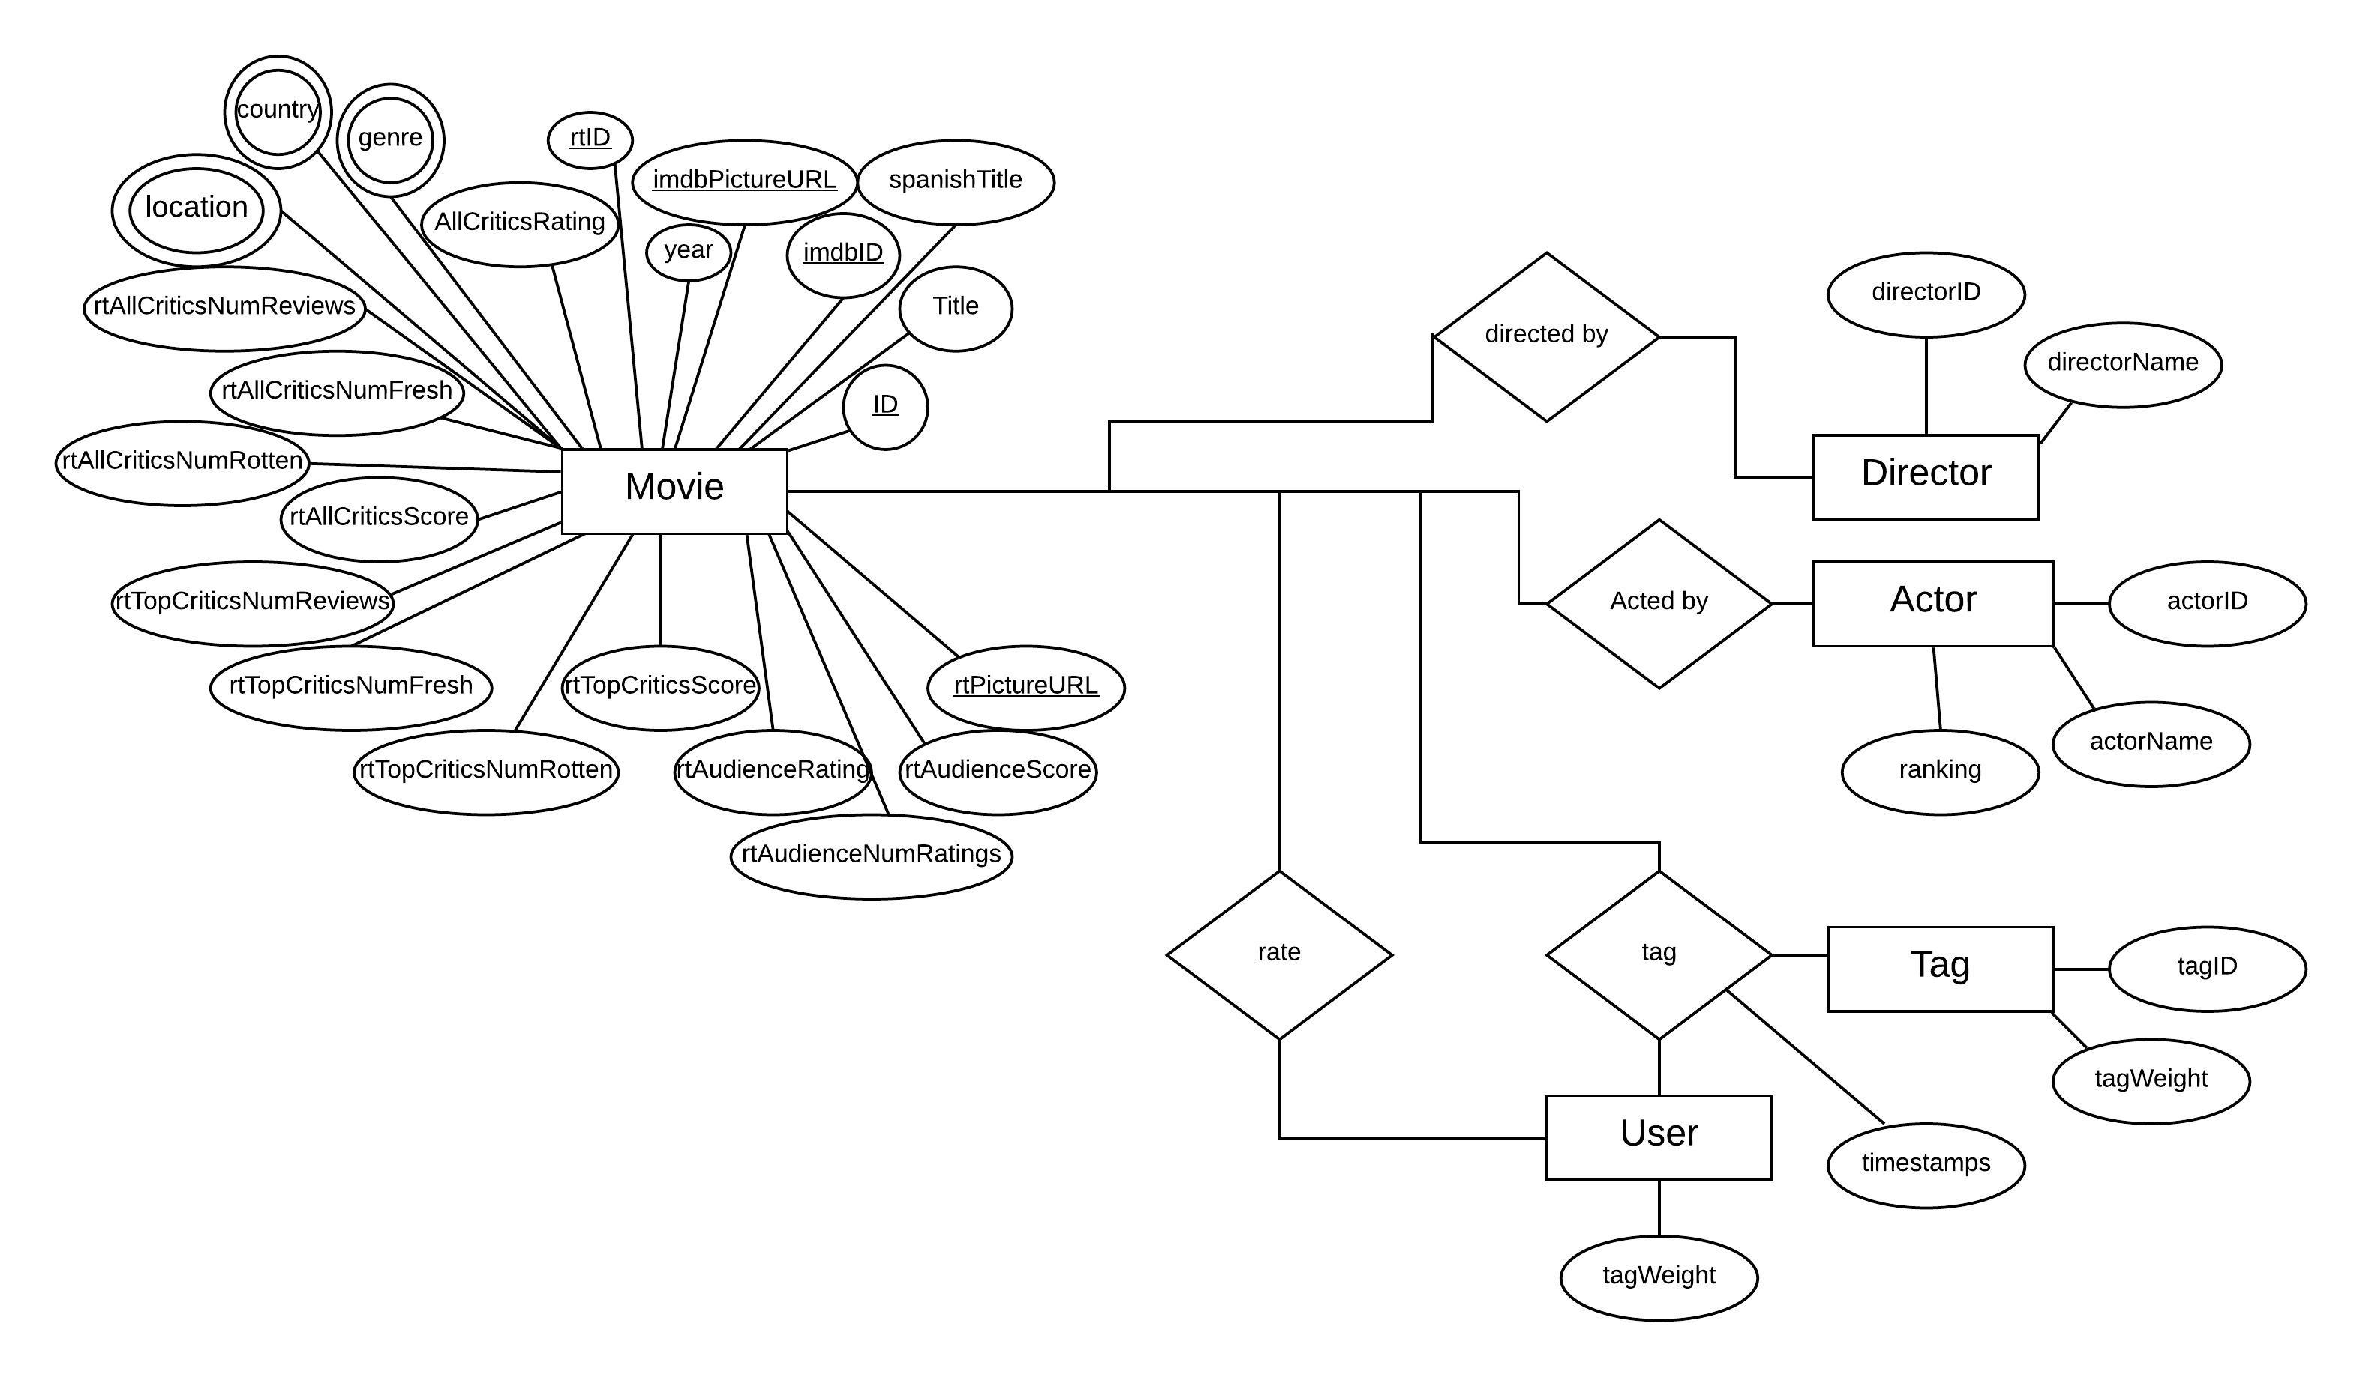
App ER Diagram

Slide 3
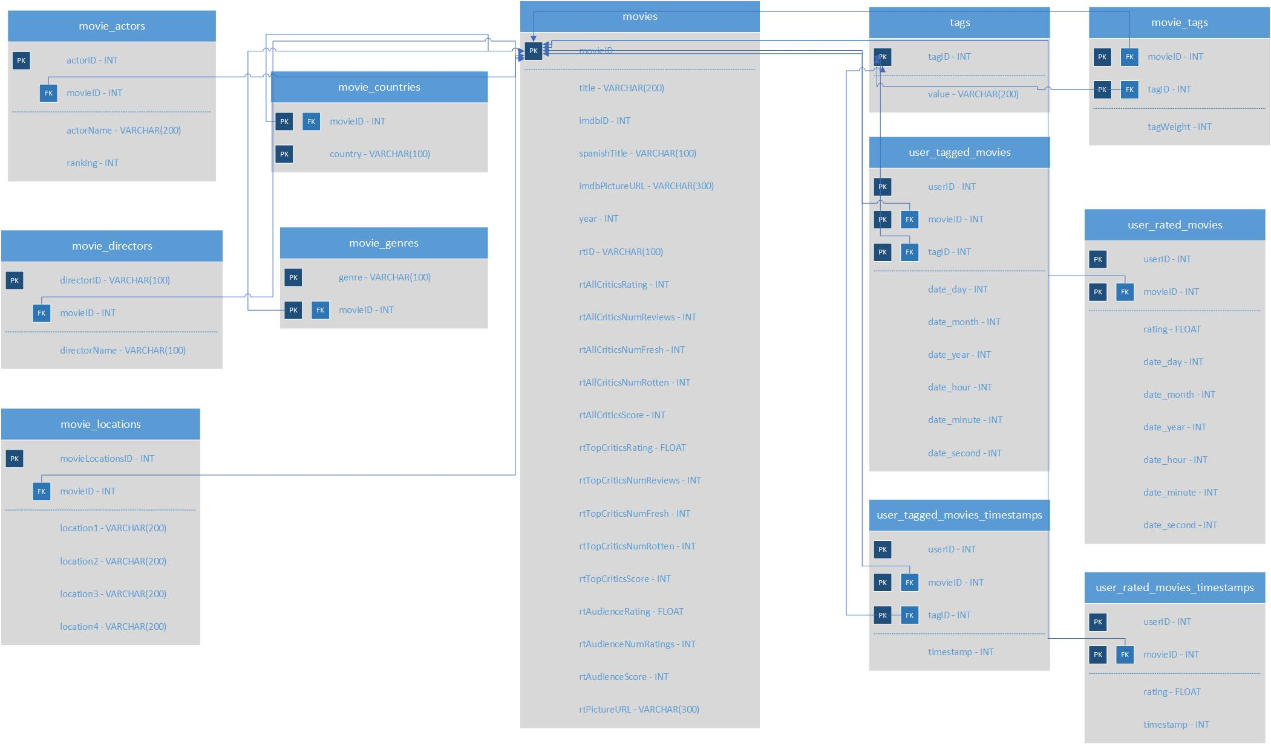
App Database Schema Diagram

Slide 4
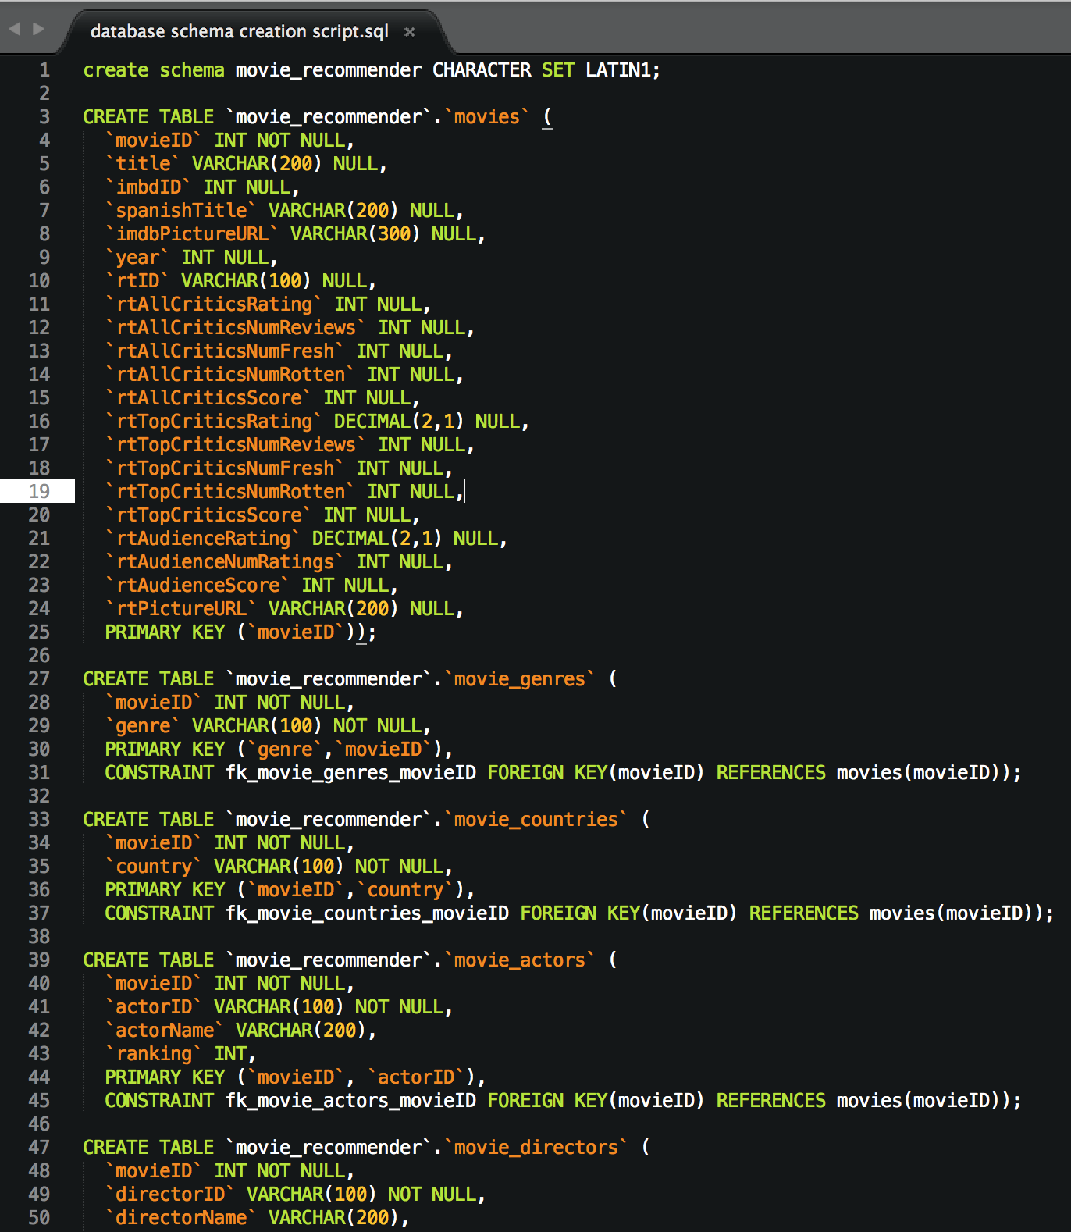
SQL Scripts

Slide 5
Parser Class Diagram

Slide 6
High Level Code Design (App Class Diagram)

Slide 7
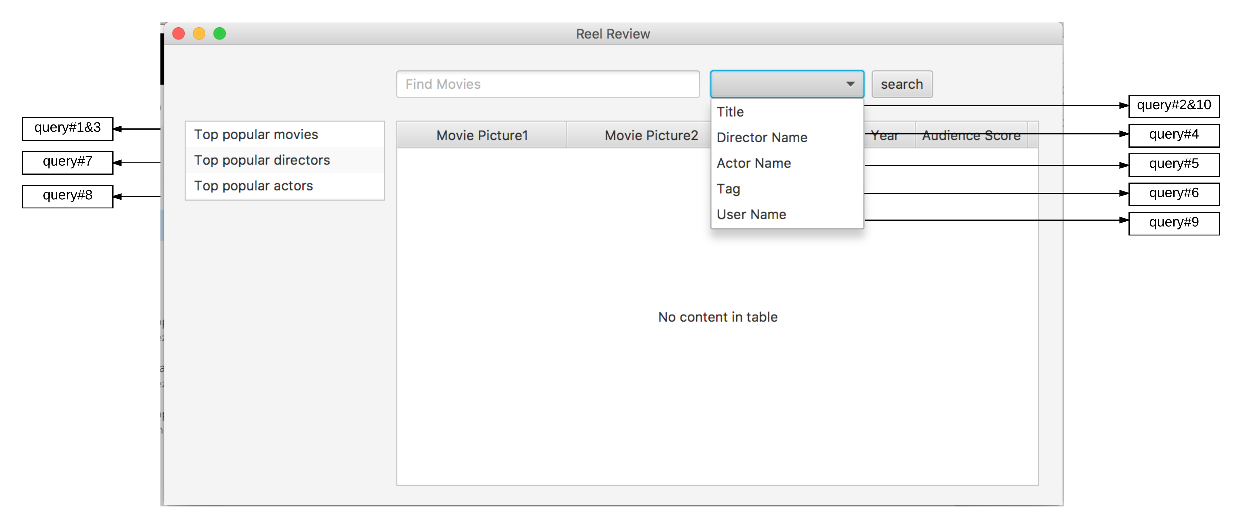
Query to User Interface Diagram (System Functionality)

